Slide 1
EE463 STATIC POWER CONVERSION – I Hardware project presentation
Metehan Küçükler

Slide 2
Outlıne
Project Requirements
Proper Topologies
Simulation Results
Analytical Calculations
Component Selections
Conclusion

Slide 3

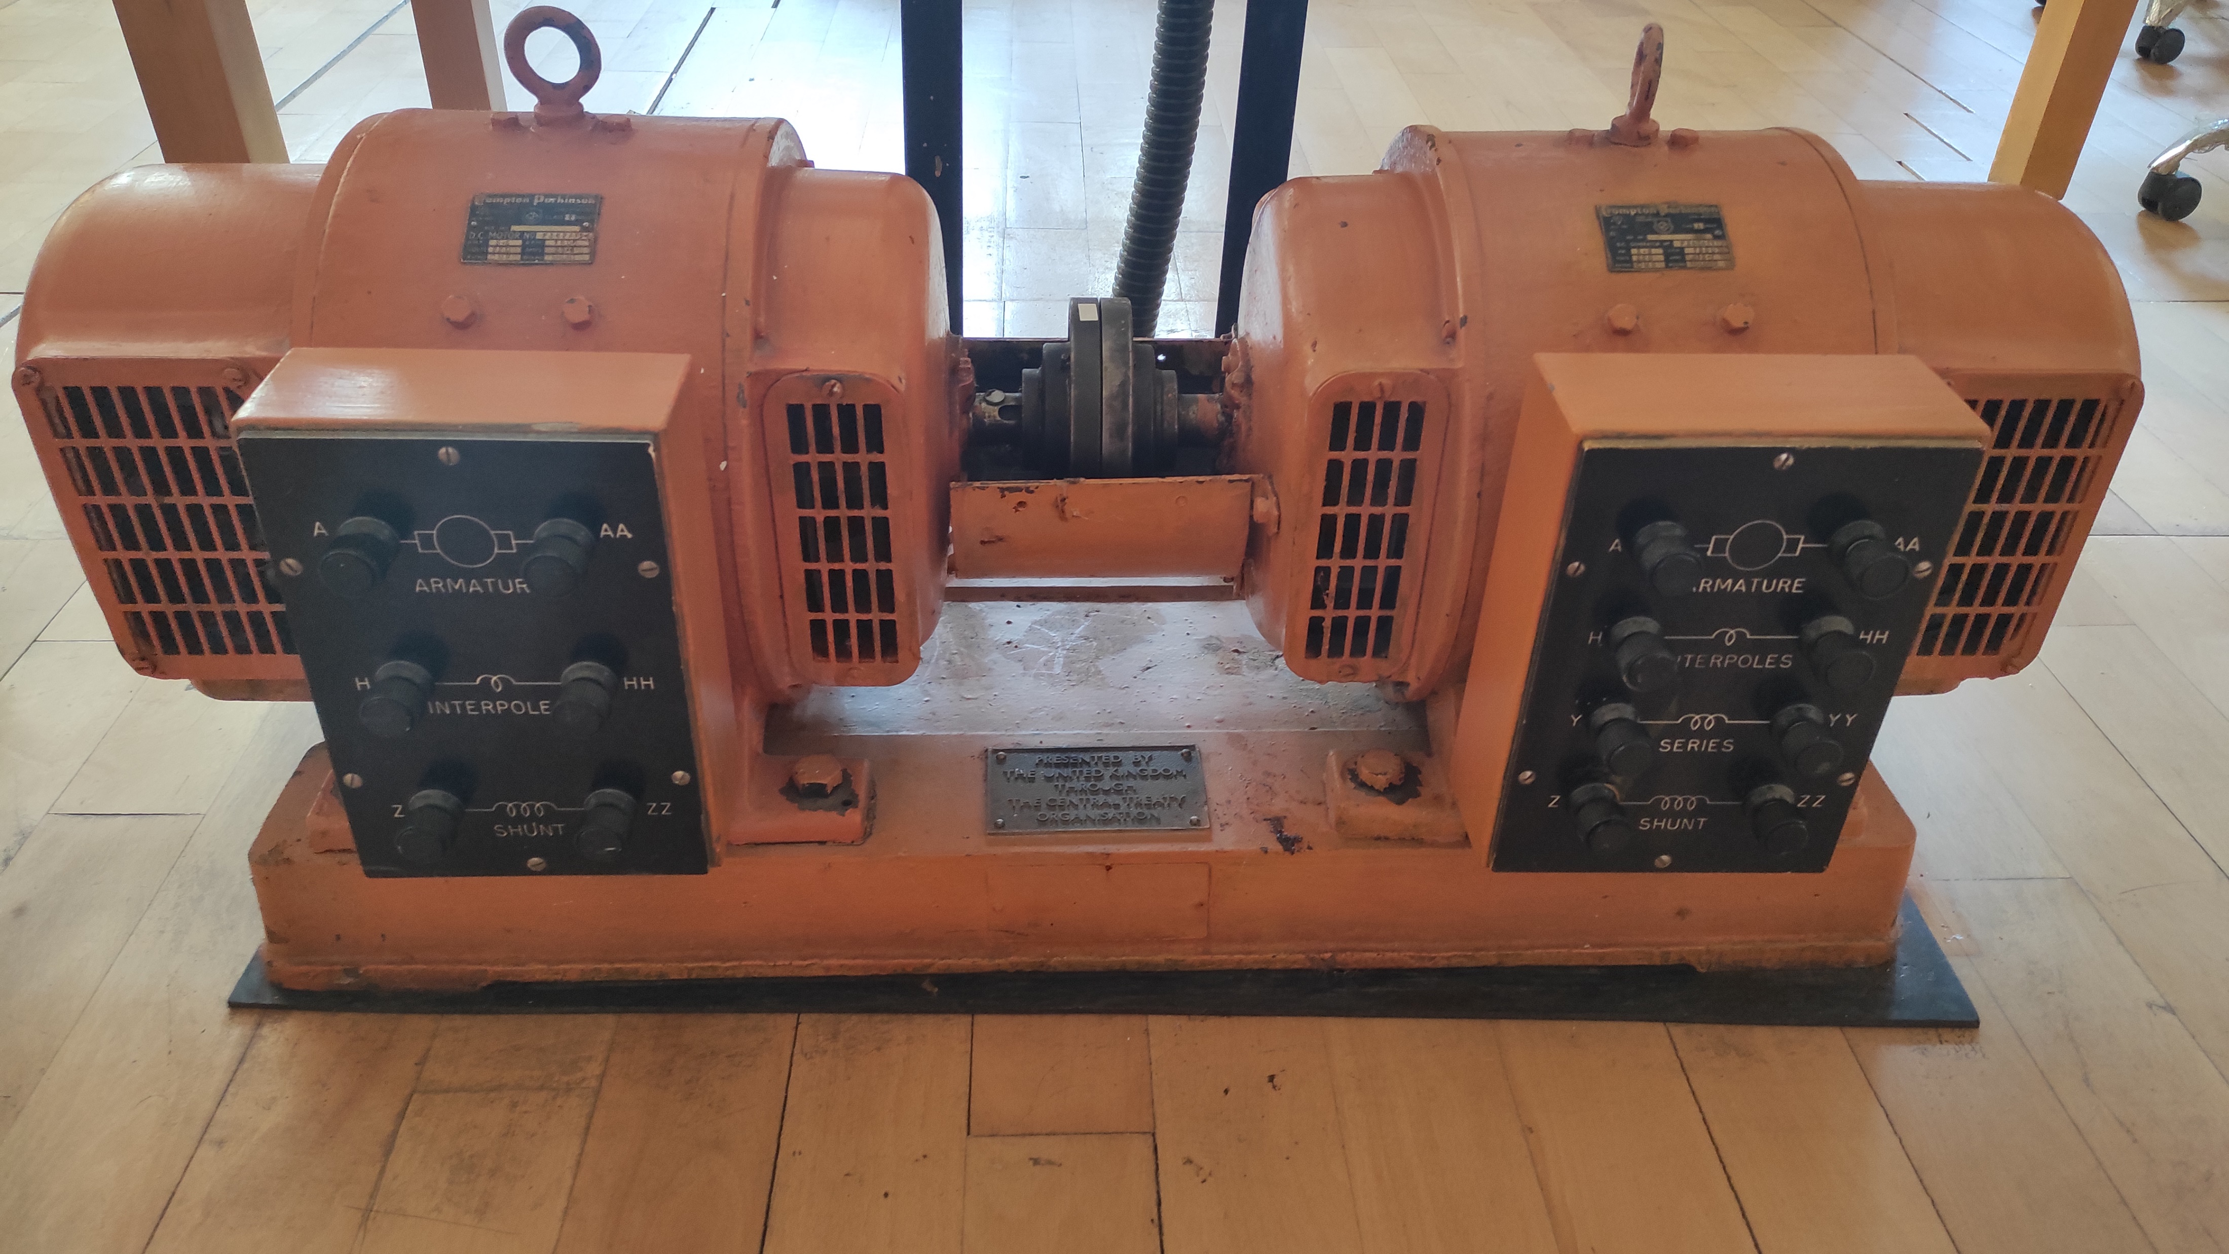
Project Requirements
Power input with 3-phase or 1-phase AC grid ( Adjustable with variac )
Output: Adjustable DC output (Vout,max = 180V)

Slide 4
Proper Topologies
Thyristor rectifier
Better for high power applications
Phase control is possible
Control circuitry is complex and costly
Dimmer circuit
Easier to control output voltage level
Easier to utilize four-quadrant operation
Control circuitry is complex and costly
Requires high filtering components
Diode rectifier and buck converter
Easier to construct
Easier to control output voltage level
Basic control circuitry
Lacks phase control

Slide 5
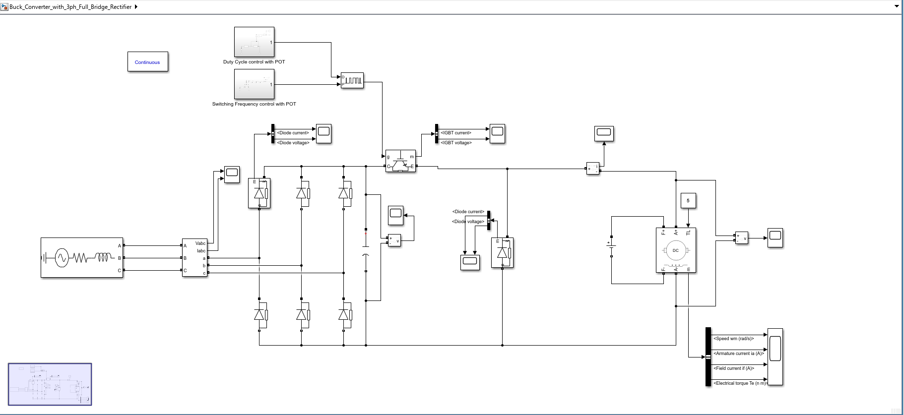
Selected Topology
Diode Rectifier and Buck Converter with manual Duty Cycle and Switching Frequency Control

Slide 6
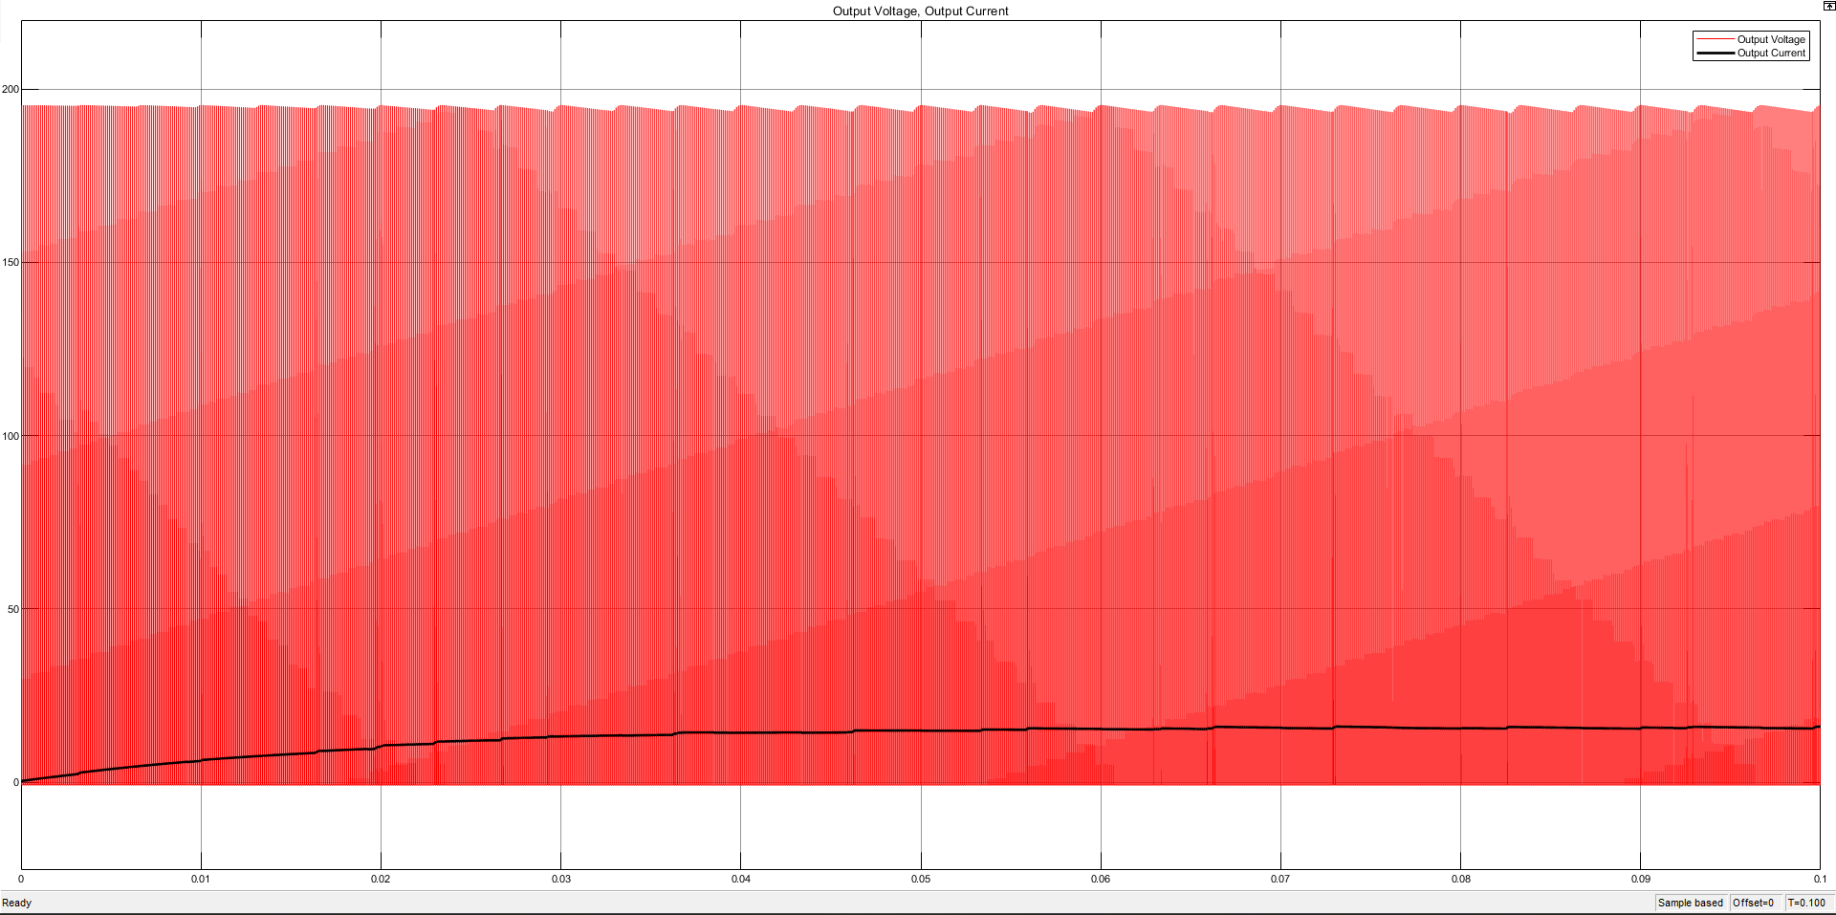
Simulation Results(with RL load)
0.2 Duty Cycle – 10 kHz switching frequency

Slide 7
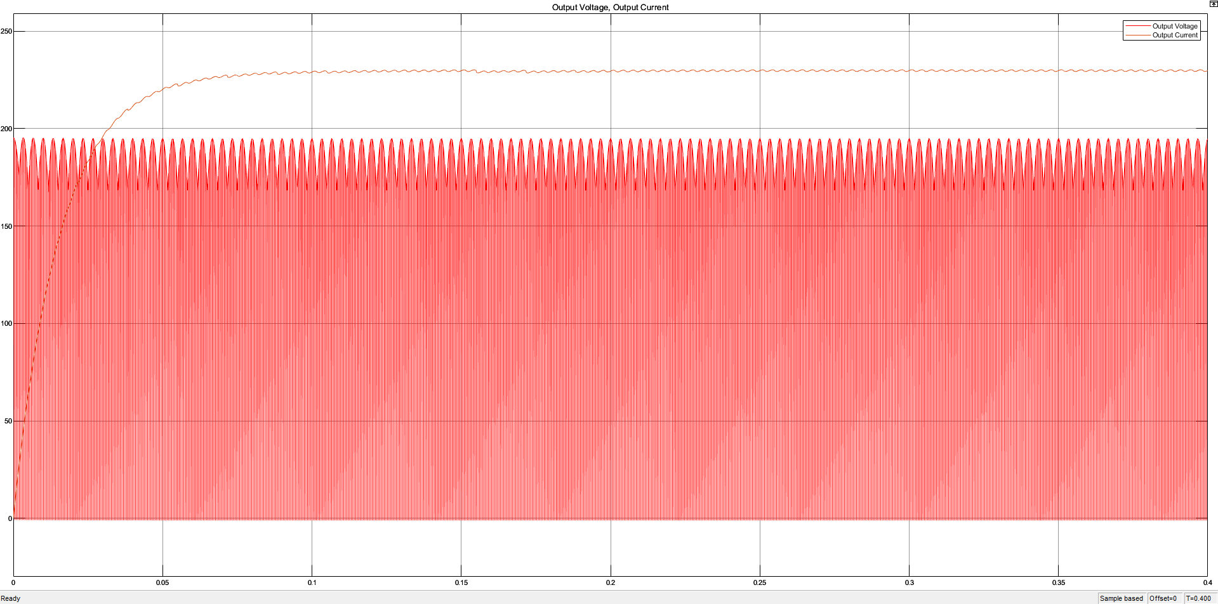
Simulation Results(with RL load)
0.9 Duty Cycle – 2 kHz switching frequency

Slide 8
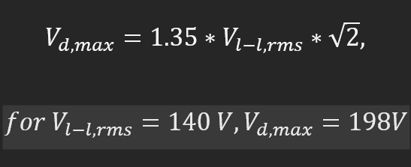
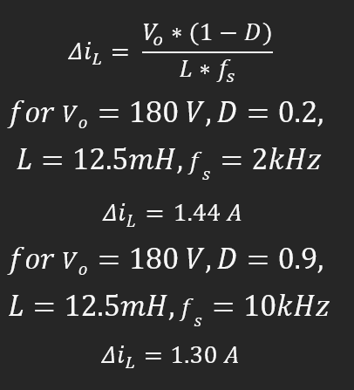
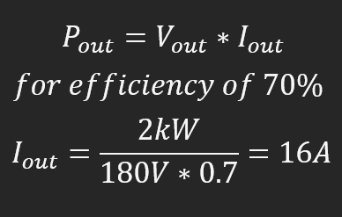
Analytical Calculations

Slide 9
Component Selection
IGBT | >400V | >25A
RECTIFIER | >400V | >25A
CAPACITOR | 400V | 3 x 470μF
POTENTIOMETER |  | 1-100kΩ
Fast Diode | >400V | >25A
Microcontroller Raspberry Pi Pico

Slide 10
Conclusion
Testing
Integration
PCB Design

